Slide 1
Library Committee Meeting
Fall 2022
03 October 2022

Slide 2
Opening
Approval of Minutes
Announcements

Slide 3
Open Access Update
Added PLOS for 2022
Negotiating contracts for additional publishers, beginning January 2023
Added additional funds for ACS & Wiley for 2022
 | ACS | IEEE | PLOS | Wiley | Total
2020 | 8 | 38 | 0 | 9 | 55
2021 | 26 | 58 | 0 | 20 | 124
2022 | 21 | 45 | 0 | 16 | 82
Total | 55 | 141 | 0 | 45 | 261

Slide 4
E-Resources

Slide 5
New Library System - Alma
Library has been using Koha since merger
Fall 2021 - approval for replacement
Alma selected
Exlibris (owned by ProQuest/Clarivate)
December 2021 – June 2022 – Library team worked with vendor to implement
30 June – Alma went into production
Primo – Public interface
Unified search of all material – physical books, e-books, journal articles, etc.

Slide 6
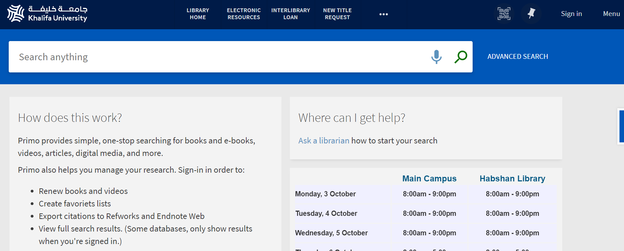
Alma – New Library System

Slide 7
IR Replacement
Alkhazna - Current system is becoming dated
Not easy to update/configure
Requires IT support
Proposed replacement: Pure
Product of Elsevier
CRIM – Comprehensive Research Information Management System
Integrates with external systems
Richer and more detailed reports
Hosted solution
Plan to create implementation team with library and other involved departments
Implemented system at KAUST: https://academia.kaust.edu.sa/

